Slide 2
High-level Abstractions, Safety, or Performance
Mateusz Pusz
Notes:
Today, we are going to analyze a short but specific scenario. We will scope on really important non-functional reuqirements, namely efficiency and safety. We will also talk about providing high-level abstractions which speeds time to market quite a lot. Without futher addo, lets start…

Slide 3
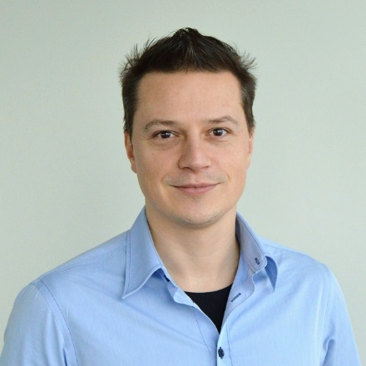
Who am I?
Modern C++ Evangelist
Hacking C++ for more than 15 years for fun and living
Trainer, coach, mentor, consultant, and conference speaker
Active voting member and contributor of the ISO C++ Committee (WG21)
MISRA C++ member
Mainly interested in code performance, low latency, safety, and maintainability
Mateusz Pusz
Associate Principal Software Engineer
Head of the C++ Competency Center
Head of EPAM Global C++ Community

Slide 4

Advanced Engineering

Slide 5
I am not claiming that C++ is the best programming language out there. Each of the programming languages has its use and areas of applicability where it proves the best. Let us not start the holy wars here 😉

Slide 6
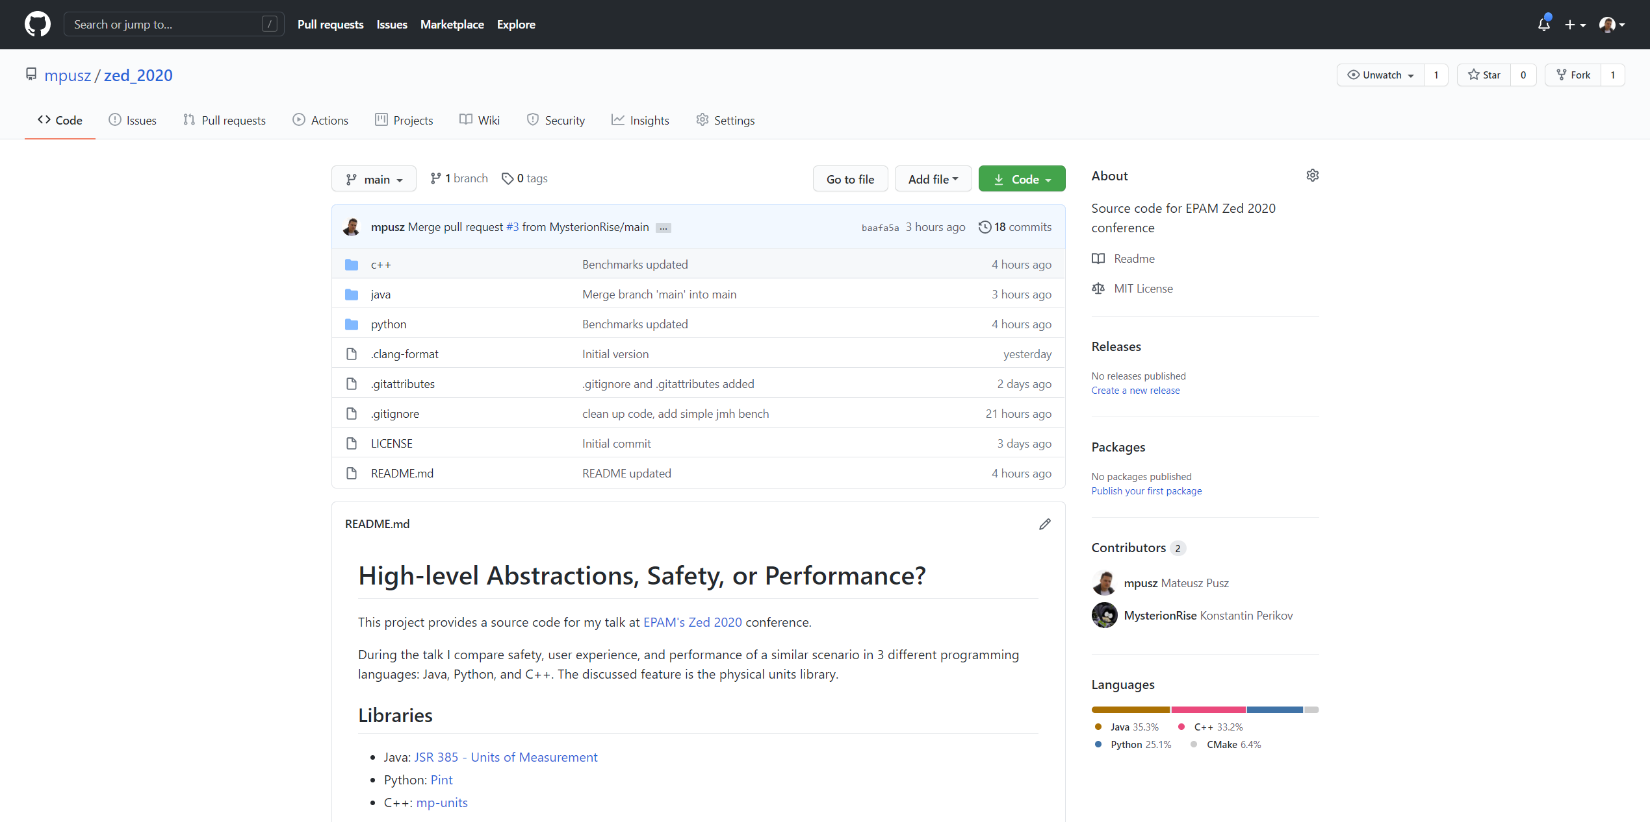
GitHub https://github.com/mpusz/zed_2020

Slide 7
Agenda
Motivation
High-level abstractions
Safety
Efficiency

Slide 8

The Mars Climate Orbiter
Robotic space probe launched by NASA on December 11, 1998
Project costs: $327.6 million
spacecraft development: $193.1 million
launching it: $91.7 million
mission operations: $42.8 million
Mars Climate Orbiter began the planned orbital insertion maneuver on September 23, 1999 at 09:00:46 UTC

Slide 9
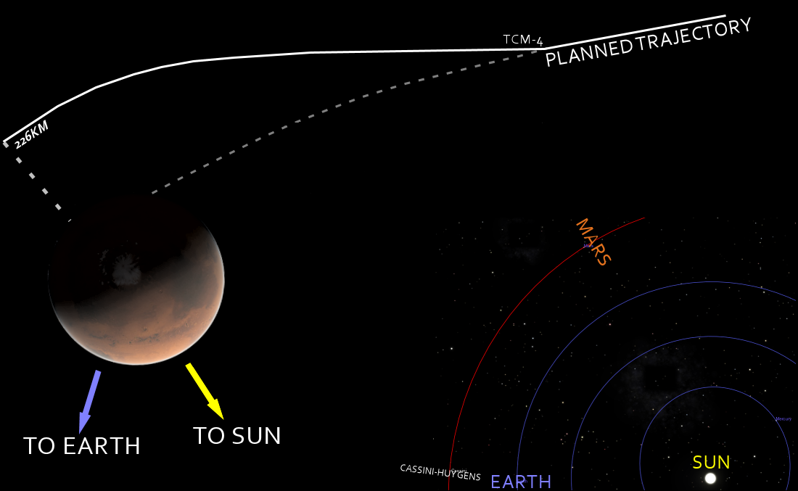
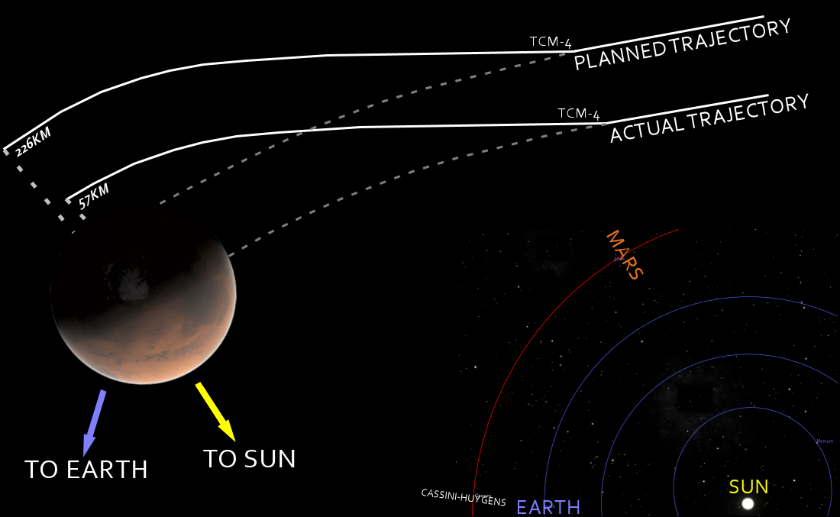

Slide 10
What went wrong?
The primary cause of this discrepancy was that
one piece of ground software supplied by Lockheed Martin produced results in a United States customary unit, contrary to its Software Interface Specification (SIS)
second system, supplied by NASA, expected those results to be in SI units, in accordance with the SIS
Specifically
software that calculated the total impulse produced by thruster firings calculated results in pound-seconds
the trajectory calculation software then used these results to update the predicted position of the spacecraft and expected it to be in newton-seconds

Slide 11


Slide 12
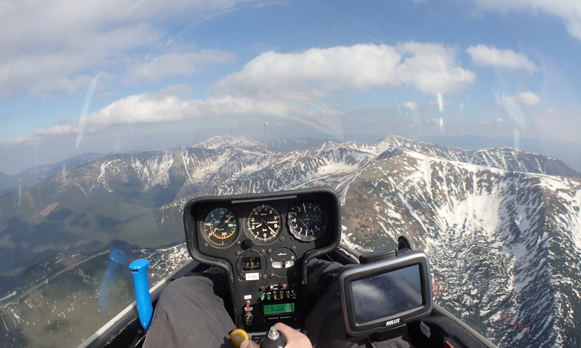
A long time ago in a galaxy far far away...

Slide 13
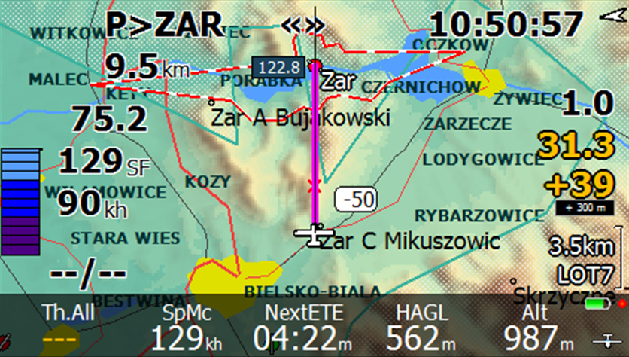
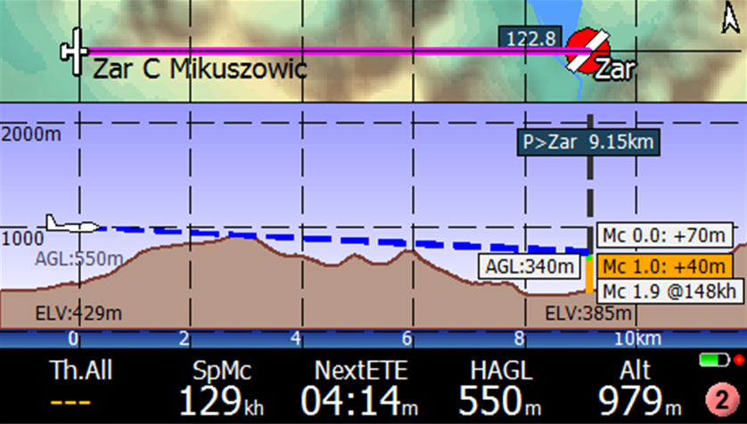
Tactical Flight Computer

Slide 14
What is the correct order?
void DistanceBearing(double lat1, double lon1,
double lat2, double lon2,
double *Distance, double *Bearing);
void FindLatitudeLongitude(double Lat, double Lon,
double Bearing, double Distance,
double *lat_out, double *lon_out);

Slide 15
double - an ultimate type
double GlidePolar::MacCreadyAltitude(double emcready,
double Distance,
const double Bearing,
const double WindSpeed,
const double WindBearing,
double *BestCruiseTrack,
double *VMacCready,
const bool isFinalGlide,
double *TimeToGo,
const double AltitudeAboveTarget,
const double cruise_efficiency,
const double TaskAltDiff);

Slide 16
Code we shouldn't write
// Air Density(kg/m3) from relative humidity(%),
// temperature(°C) and absolute pressure(Pa)
double AirDensity(double hr, double temp, double abs_press)
{
return (1/(287.06 * (temp + 273.15))) *
(abs_press - 230.617 * hr * exp((17.5043 * temp)/(241.2 + temp)));
}

Slide 17

Now it is more important then ever

Slide 18
Agenda
Motivation
High-level abstractions
Safety
Efficiency

Slide 19
Comparison Scenario
Implement avg_speed function that takes length and time arguments and returns speed in the unit derived from the units of function arguments
Calculate avg_speed(220 km, 2 h) and print the result in km/h and m/s
Calculate avg_speed(140 mi, 2 h) and print the result in mi/h and m/s

Slide 20

Pint
Python package to define, operate and manipulate physical quantities
It allows arithmetic operations between them and conversions from and to different units
It is distributed with a comprehensive list of physical units, prefixes and constants.

Slide 21
Pint
ureg = UnitRegistry()
@ureg.check('[length]', '[time]')
def avg_speed(d, t):
speed = d / t
if not speed.check('[speed]'):
raise RuntimeError("Not a [speed] dimension")
return speed
s1 = avg_speed(220 * ureg.kilometer, 2 * ureg.hour)
s2 = avg_speed(140 * ureg.mile, 2 * ureg.hour)
def print_si(q):
print('{:~P}'.format(q))
print_si(s1)
print_si(s2)
print_si(s1.to('metre/second’))
print_si(s2.to_base_units())
110.0 km/hr
70.0 mi/hr
30.555555555555557 m/s
31.292800000000003 m/s

Slide 22

JSR 385
The Unit of Measurement API
Provides a set of Java language programming interfaces for handling units and quantities
checking of unit compatibility
expression of a quantity in various units
arithmetic operations on units

Slide 23
JSR 385
public static Quantity<Speed> avg_speed(Quantity<Length> length,
Quantity<Time> time) throws ClassCastException {
return length.divide(time).asType(Speed.class);
}
final Quantity<Speed> s1 = avg_speed(Quantities.getQuantity(220., KILO(Units.METRE)),
Quantities.getQuantity(2., Units.HOUR));
final Quantity<Speed> s2 = avg_speed(Quantities.getQuantity(140., MILE),
Quantities.getQuantity(2., Units.HOUR));
System.out.println(s1);
System.out.println(s2);
System.out.println(s1.to(Units.METRE_PER_SECOND));
System.out.println(s2.toSystemUnit());
110 km/h
70 mi/h
30.55555555555555555555555555555556 m/s
31.2928 m/s

Slide 24

mp-units
Modern C++ library
Provides compile-time dimensional analysis and unit/quantity manipulation
no runtime execution or memory storage space cost is introduced
Support for quantities and units for arbitrary unit system models and arbitrary value types
Planned for the ISO standardization as a part of the C++23/26

Slide 25
mp-units
constexpr Speed auto avg_speed(Length auto d, Time auto t)
{
return d / t;
}
Speed auto s1 = avg_speed(si::length<si::kilometre>(220), si::time<si::hour>(2));
Speed auto s2 = avg_speed(si::length<si::international::mile>(140), si::time<si::hour>(2));

Slide 26
mp-units
constexpr Speed auto avg_speed(Length auto d, Time auto t)
{
return d / t;
}
Speed auto s1 = avg_speed(220_q_km, 2_q_h);
Speed auto s2 = avg_speed(140_q_mi, 2_q_h);
std::cout << s1 << '\n';
std::cout << s2 << '\n';
std::cout << quantity_cast<si::metre_per_second>(s1) << '\n';
std::cout << quantity_cast<si::dim_speed::coherent_unit>(s2) << '\n';
110 km/h
70 mi/h
30.5556 m/s
31.2928 m/s

Slide 27
Agenda
Motivation
High-level abstractions
Safety
Efficiency

Slide 28
Comparison Scenario
Ensure that for reordered arguments avg_speed(2 h, 220 km) returns an error
Ensure that an error is reported when avg_speed returns the result of an invalid calculation
function multiplies the arguments instead of dividing them
the result is not a quantity of speed

Slide 29
Pint – reordered arguments
@ureg.check('[length]', '[time]')
def avg_speed(d, t):
speed = d / t
if not speed.check('[speed]'):
raise RuntimeError("Not a [speed] dimension")
return speed
s1 = avg_speed(2 * ureg.hour, 220 * ureg.kilometer)
Traceback (most recent call last):
File "safety_1.py", line 13, in <module>
s1 = avg_speed(2 * ureg.hour, 220 * ureg.kilometer)
File "/home/mpusz/.local/lib/python3.8/site-packages/pint/registry_helpers.py", line 350, in wrapper
raise DimensionalityError(value, "a quantity of", val_dim, dim)
pint.errors.DimensionalityError: Cannot convert from '2 hour' ([time]) to 'a quantity of' ([length])
Runtime Error

Slide 30
Pint – invalid computation
@ureg.check('[length]', '[time]')
def avg_speed(d, t):
speed = d * t
if not speed.check('[speed]'):
raise RuntimeError("Not a [speed] dimension")
return speed
s1 = avg_speed(220 * ureg.kilometer, 2 * ureg.hour)
Traceback (most recent call last):
File "safety_2.py", line 14, in <module>
s1 = avg_speed(220 * ureg.kilometer, 2 * ureg.hour)
File "/home/mpusz/.local/lib/python3.8/site-packages/pint/registry_helpers.py", line 351, in wrapper
return func(*args, **kwargs)
File "safety_2.py", line 10, in avg_speed
raise RuntimeError("Not a [speed] dimension")
RuntimeError: Not a [speed] dimension
Runtime Error

Slide 31
JSR 385 – reordered arguments
public static Quantity<Speed> avg_speed(Quantity<Length> length,
Quantity<Time> time) throws ClassCastException {
return length.divide(time).asType(Speed.class);
}
public static void main(String[] args) {
final Quantity<Speed> s = avg_speed(Quantities.getQuantity(2., Units.HOUR),
Quantities.getQuantity(220., KILO(Units.METRE)));
}
[ERROR] Safety_1.java:[41,31] incompatible types: inference variable Q has incompatible equality constraints javax.measure.quantity.Length,javax.measure.quantity.Time
Compile-time Error

Slide 32
JSR 385 – invalid computation
public static Quantity<Speed> avg_speed(Quantity<Length> length,
Quantity<Time> time) throws ClassCastException {
return length.multiply(time).asType(Speed.class);
}
public static void main(String[] args) {
final Quantity<Speed> s = avg_speed(Quantities.getQuantity(220., KILO(Units.METRE)),
Quantities.getQuantity(2., Units.HOUR));
}
Exception in thread "main" java.lang.ClassCastException: The unit: km·h is not compatible with quantities of type interface javax.measure.quantity.Speed
at tech.units.indriya.AbstractUnit.asType(AbstractUnit.java:277)
at tech.units.indriya.AbstractUnit.asType(AbstractUnit.java:89)
at tech.units.indriya.AbstractQuantity.asType(AbstractQuantity.java:337)
at tech.units.indriya.AbstractQuantity.asType(AbstractQuantity.java:114)
at zed2020.Safety_2.avg_speed(Safety_2.java:37)
at zed2020.Safety_2.main(Safety_2.java:41)
Runtime Error

Slide 33
mp-units – reordered arguments
constexpr Speed auto avg_speed(Length auto d, Time auto t)
{
return d / t;
}
Speed auto s1 = avg_speed(2_q_h, 220_q_km);
avg_speed.cpp: In function ‘int main()’:
avg_speed.cpp:45:44: error: use of function ‘constexpr Speed auto avg_speed(auto:16, auto:17) [with auto:16 = units::quantity<units::physical::si::dim_time, units::physical::si::hour, long int>; auto:17 = units::quantity<units::physical::si::dim_length, units::physical::si::kilometre, long int>]’ with unsatisfied constraints
45 | Speed auto s1 = avg_speed(2_q_h, 220_q_km);
| ^
avg_speed.cpp:29:16: note: declared here
29 | constexpr Speed auto avg_speed(Length auto d, Time auto t)
| ^~~~~~~~~
Compile-time Error

Slide 34
mp-units – invalid computation
constexpr Speed auto avg_speed(Length auto d, Time auto t)
{
return d * t;
}
Speed auto s1 = avg_speed(220_q_km, 2_q_h);
In instantiation of ‘constexpr auto [requires units::physical::Speed<<placeholder>, >] avg_speed(auto:16, auto:17) [with auto:16 = units::quantity<units::physical::si::dim_length, units::physical::si::kilometre, long int>; auto:17 = units::quantity<units::physical::si::dim_time, units::physical::si::hour, long int>]’:
avg_speed.cpp:42:44: required from here
avg_speed.cpp:32:14: error: deduced return type does not satisfy placeholder constraints
32 | return d * t;
| ^
Compile-time Error

Slide 35
Agenda
Motivation
High-level abstractions
Safety
Efficiency

Slide 36
Comparison Scenario
Benchmark the following scenarios both for operations on fundamental/primitive types and on high-level quantity abstractions
Arithmetic - create quantities of length and time and divide them to obtain speed
Scaling - create a quantity of speed and convert the unit from km/h to m/s

Slide 37
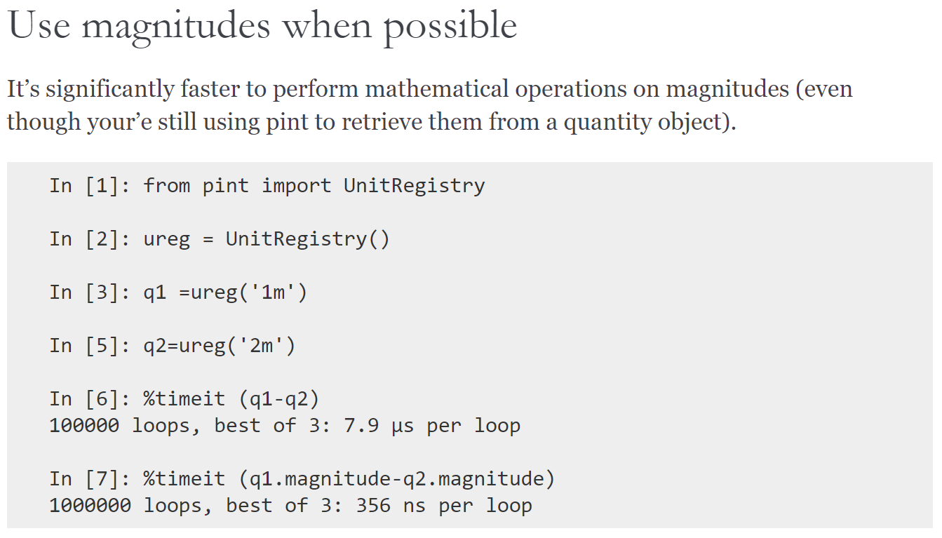
Pint

Slide 38
Pint

Slide 39
JSR 385

Slide 40
mp-units

Slide 41
mp-units
constexpr double avg_speed(double d, double t)
{
return d / t;
}
avg_speed(...):
divsd xmm0, xmm1
ret
constexpr Speed auto avg_speed(Length auto d, Time auto t)
{
return d / t;
}
avg_speed(...):
divsd xmm0, xmm1
ret
High-level abstractions without sacrificing runtime performance

Slide 42
Compile-time evaluation when possible
// simple numeric operations
static_assert(10_q_km / 2 == 5_q_km);
// unit conversions
static_assert(1_q_h == 3600_q_s);
static_assert(1_q_km + 1_q_m == 1001_q_m);
// dimension conversions
static_assert(1_q_km / 1_q_s == 1000_q_m_per_s);
static_assert(2_q_km_per_h * 2_q_h == 4_q_km);
static_assert(2_q_km / 2_q_km_per_h == 1_q_h);
static_assert(2_q_m * 3_q_m == 6_q_m2);
static_assert(10_q_km / 5_q_km == 2);
static_assert(1000 / 1_q_s == 1_q_kHz);

Slide 43
Comparison (Arithmetic)

Slide 44
Efficiency is not just running fast or running bigger programs, it’s also running using less resources.
Bjarne Stroustrup, June 2011

Slide 45
Pint
Quantity
_magnitude
_units
__used
__handling
from pympler import asizeof
def test_data(count, min, max):
values = default_rng().uniform(min, max, count)
return list(map(lambda s: s * ureg.kilometre / ureg.hour, values))
print(asizeof.asizeof(test_data(10000, 40, 140)), "bytes")
1 Quantity ~ 700 bytes
6963520 bytes

Slide 46
JSR 385
Quantity
int
(16 bytes)
Not shared
header (12 bytes)
value (4 bytes)
unit (4 bytes)
scale (4 bytes)
Shared
ProductUnit
Quantity$Scale
Quantity[] quantities = new Quantity[10000];
for (int i = 0; i < quantities.length; ++i) {
quantities[i] = avg_speed(Quantities.getQuantity(Math.random() * 1000, KILO(Units.METRE)),
Quantities.getQuantity(Math.random() * 10, Units.HOUR));
}
System.out.println(RamUsageEstimator.sizeOf(quantities) + " bytes");
1 Quantity ~ 500 bytes
5001128 bytes

Slide 47
mp-units
quantity<Dimension D, UnitOf<D> U, QuantityValue Rep>
Rep value
namespace si {
template<UnitOf<dim_length> U, QuantityValue Rep = double>
using length = quantity<dim_length, U, Rep>;
}
static_assert(sizeof(si::length<si::metre>) == sizeof(double));
static_assert(sizeof(si::length<si::metre, int>) == sizeof(int));
static_assert(sizeof(si::length<si::metre, std::int8_t>) == 1);

Slide 48
Modern C++ provides safety and high-level abstractions without sacrificing on efficiency.

Slide 49
Thank you!

